Slide 1
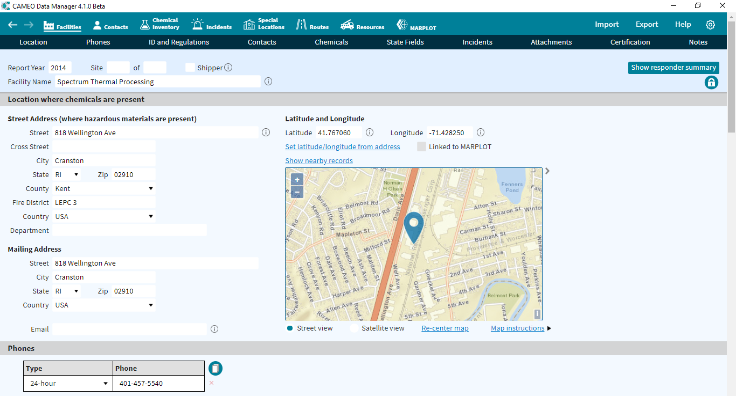
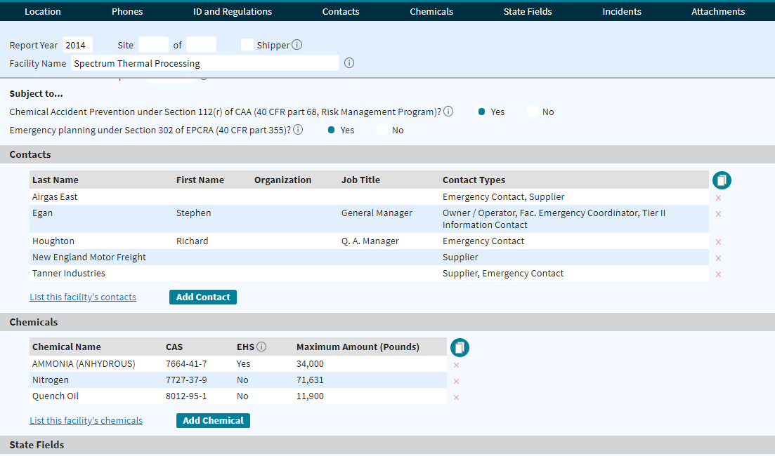
Case Study: Spectrum Heat Treating

Slide 2
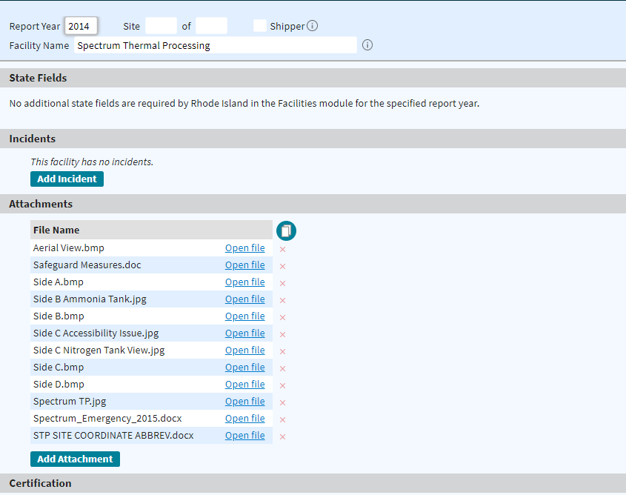
Notes:
Example of their report imported into latest version of CAMEODM

Slide 3
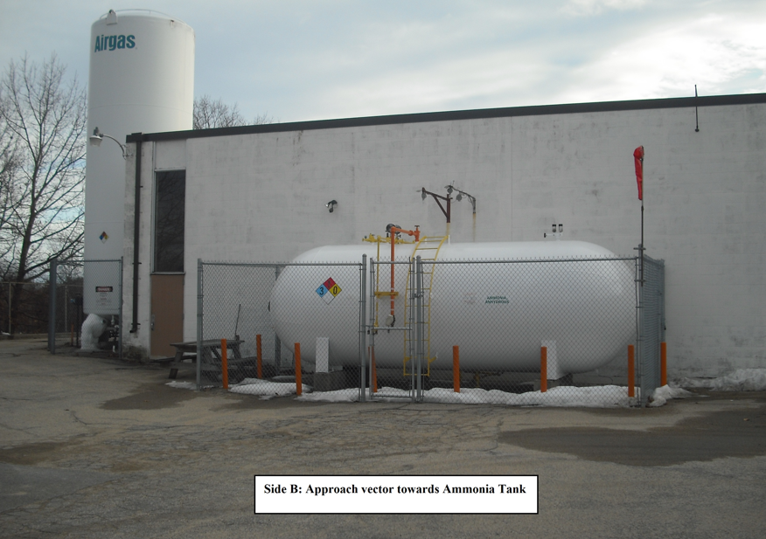
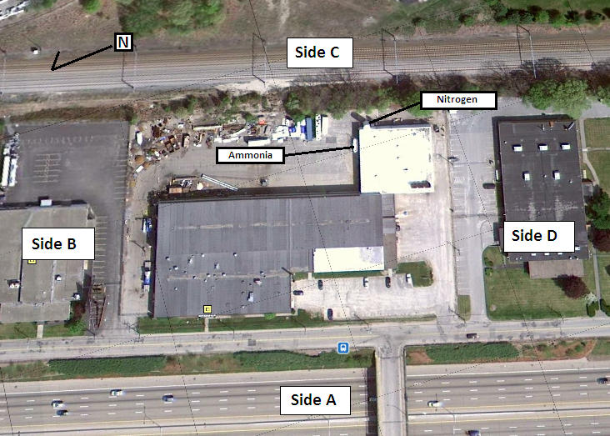
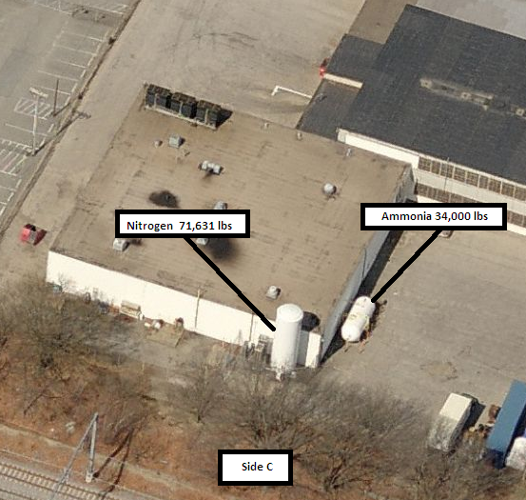
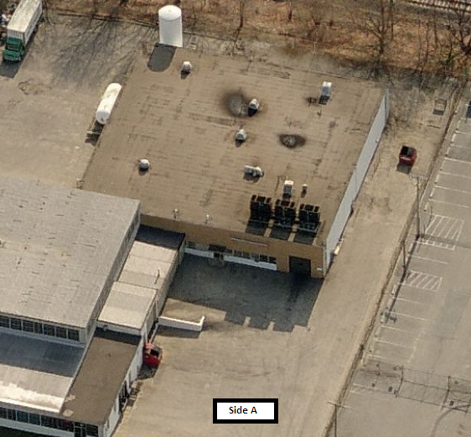
Notes:
Robust images that are supplied via report

Slide 4
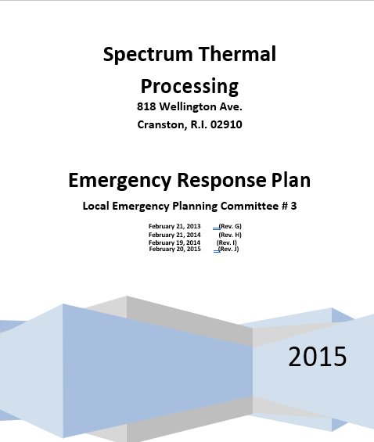
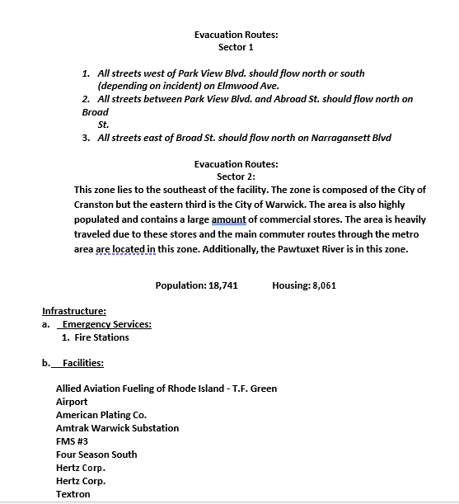
Notes:
Emergency Response Plan, which is in it 10th version

Slide 5
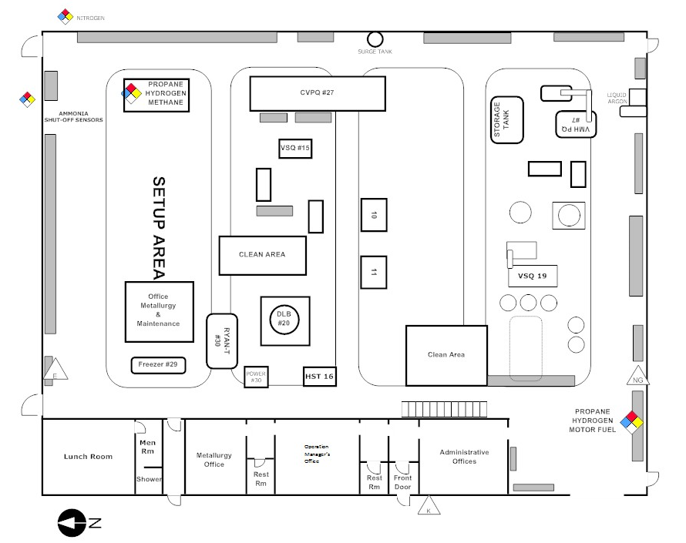
Notes:
Detailed site plan, newly developed for their tier 2 report.
That evening, a fire alarm sounding brought a compliment from the Cranston Fire Department, RI to the scene. They encountered heavy smoke from the front of the building.
First arriving Command vehicle directed units to the interior of the building and to utilize access stairs to the roof. HVAC unit fire was quickly extinguished with a dry chemical extinguisher. Business was only interrupted for 30 minutes.

Slide 6
Mystic REPC Commodity Project
Utilizing The cameo suite to category hazmat commodities within the region

Slide 7
Scope
To conduct a hazardous materials commodity flow study focused on the 26 (now grown to 28) member communities of the Mystic REPC. The study would begin with the approximately 140 (now grown to 196) facilities that report the use, production and storage of Extremely Hazardous Substances (EHS) and the routes used as they are transported within the communities. The completed data would also be mapped in GIS application and all information compiled would be provided to each community.
Notes:
The Mystic REPC (Northeastern Massachusetts is made up of 28 communities. They act under the authority of EPCRA under the Massachusetts EMA.
Utilizing HMEP funding, they wanted to build a commodity flow study with information provided from existing Tier 2 reports and the CAMEO software suite that could be effectively used by local planners and first responders.

Slide 8
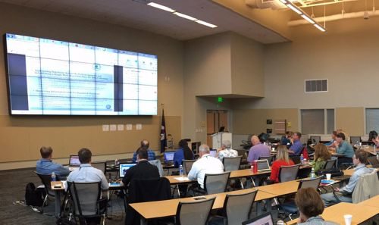
Training
Training will be provided to all communities to help make the best use of the data with their local emergency plans
Notes:
Once completed, the database would be presented to the community and each first response agency to begin to identify potential risk and begin planning.

Slide 9
Objectives
Develop CAMEO Database to provide Tier II report data for reporting years 2018-2021
Determine inventories that are transported throughout the Region based on 2021 Tier 2 submissions
Generate routes within the GIS Application, MARPLOT & link them to a CAMEO Data Manager record.
Notes:
Each community would be given as complete of a database as possible from available information through their Tier 2 Manager system. Each record was “scrubbed” through Tier 2 Submit in order to correct data entry mistakes.

Slide 10
Solving the Problem: EPZs
Hazards: What is the problem or concern?
Geography: Where is it happening? Jurisdiction?
Demographics: Who is being affected?
Emergency Service Organization: What resources and availability to respond or assist?
HAZARD + VULNERABILITY = LEVEL OF EMERGENCY
Problem?
Who’s being affected?
Can we change the outcome?
Notes:
The Emergency Planning Zone concept: Every policy, procedure, plan, and guideline has a formula that can be utilized to logically effect our strategic and tactical options.
Most emergency managers understand this concept. With the unique structure of hazardous material incidents, responders need to identify this process and execute viable responses based upon all the clues each incident presents.

Slide 11

CAMEO DM Facility & Route Records
435 Reporting Facilities*
  280 EPA 302 Facilities (EHS)
  170 EHS Routes throughout the Region
* Designates 453 reporting facilities in previous year
Notes:
What are our major concerns

Slide 12
Mystic REPC Region
Notes:
Begin the equation: First, identifying our jurisdiction

Slide 13
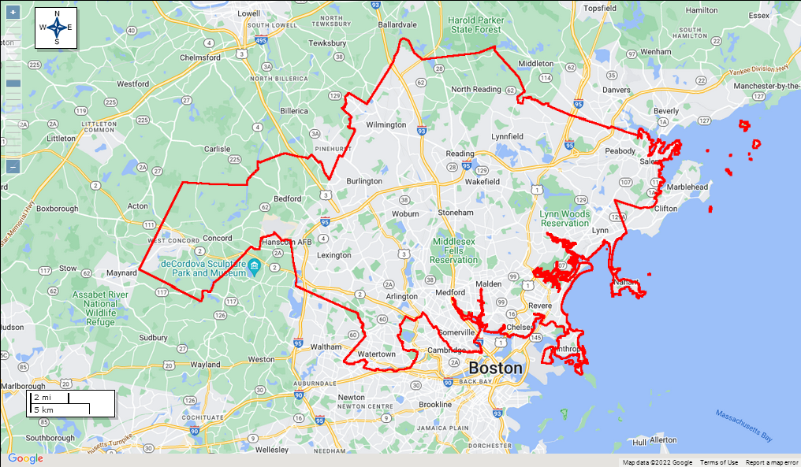
Mystic REPC Region
Area: 253 sq. Miles
Population: 943,044
Housing units:
395,363
Notes:
Jurisdiction: 253 square miles
Population: 943,044 (Demographics)
Housing Units: 395,363

Slide 14
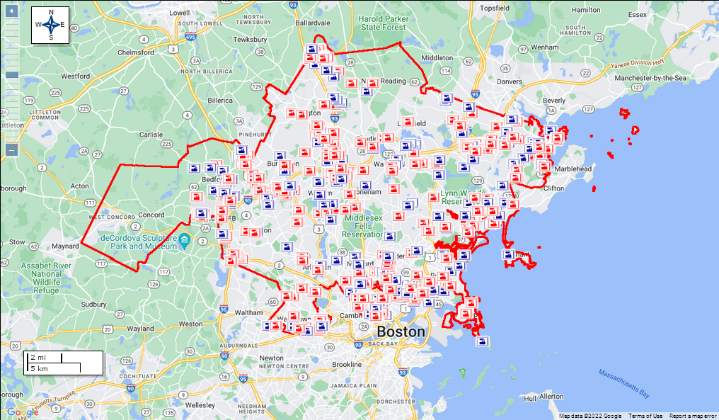
Mystic REPC Region: 2021 Tier 2 Reporters
Area: 253 sq. Miles
2021 Tier 2: 435
Notes:
Identifying HAZARDS
435 reporters

Slide 15
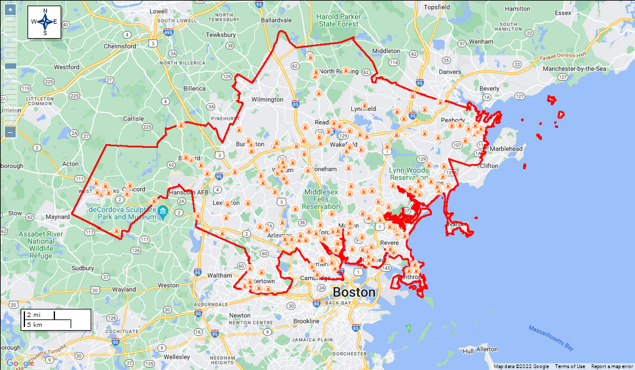
Mystic REPC Region: Service Stations
Area: 253 sq. Miles
2021 Tier 2: 435
Service Stations: 252

Slide 16
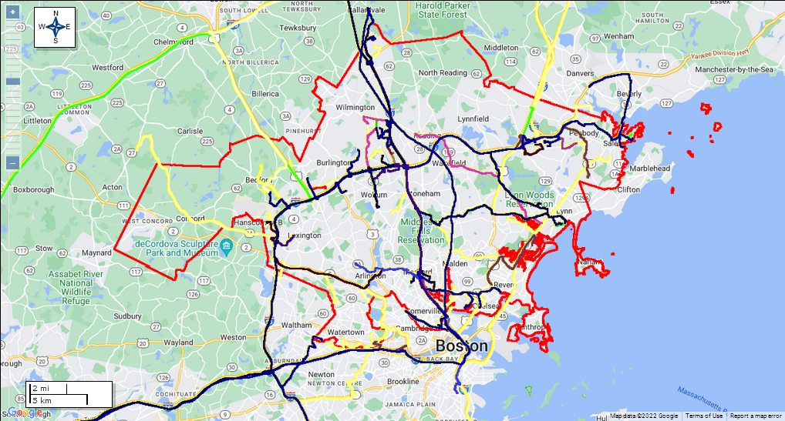
Mystic REPC Region: Routes
Area: 253 sq. Miles
Routes: 4655 miles of reported travel routes
Notes:
Once completed, EHS routes there were mapped out, represented 4,655 miles

Slide 17
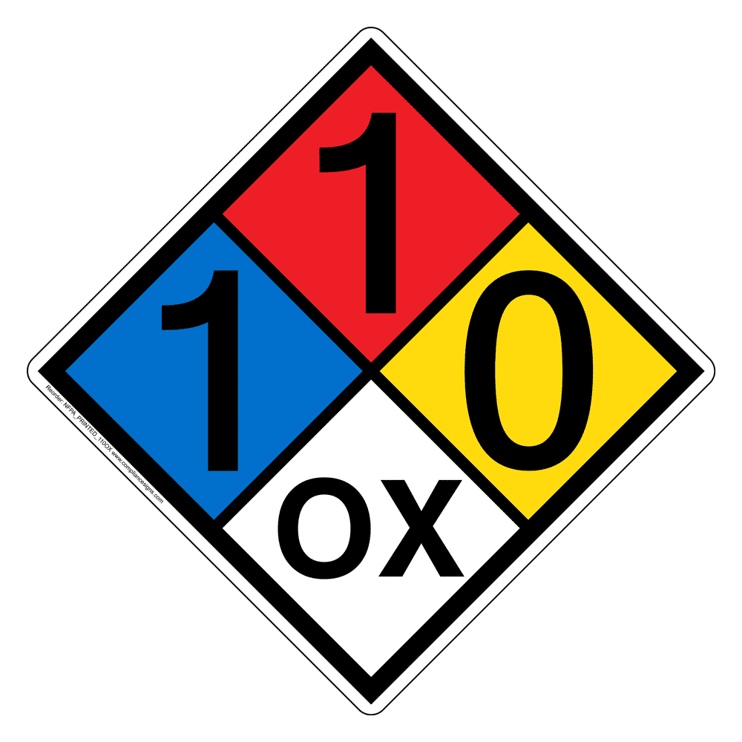
NFPA 704 & Route Color Designations
BLUE: TOXICITY
RED: FLAMMABILITY
YELLOW: REACTIVITY
WHITE: CORROSIVE
PURPLE: COMBINATION BLUE/RED
GREEN: COMBINATION BLUE/YELLOW
Notes:
Kept color coding system simple to match NFPA 704, thereby identifying potential harm and risk

Slide 18
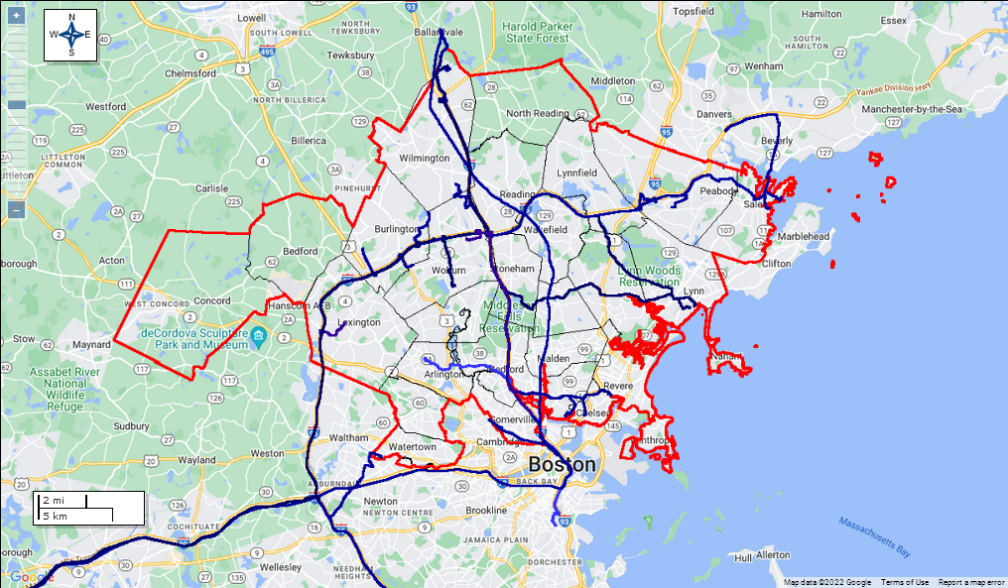
Ammonia in the Region
Notes:
Database becomes searchable. This represents Ammonia traveling throughout the region

Slide 19

Notes:
How can this data be useful to a community?

Slide 20
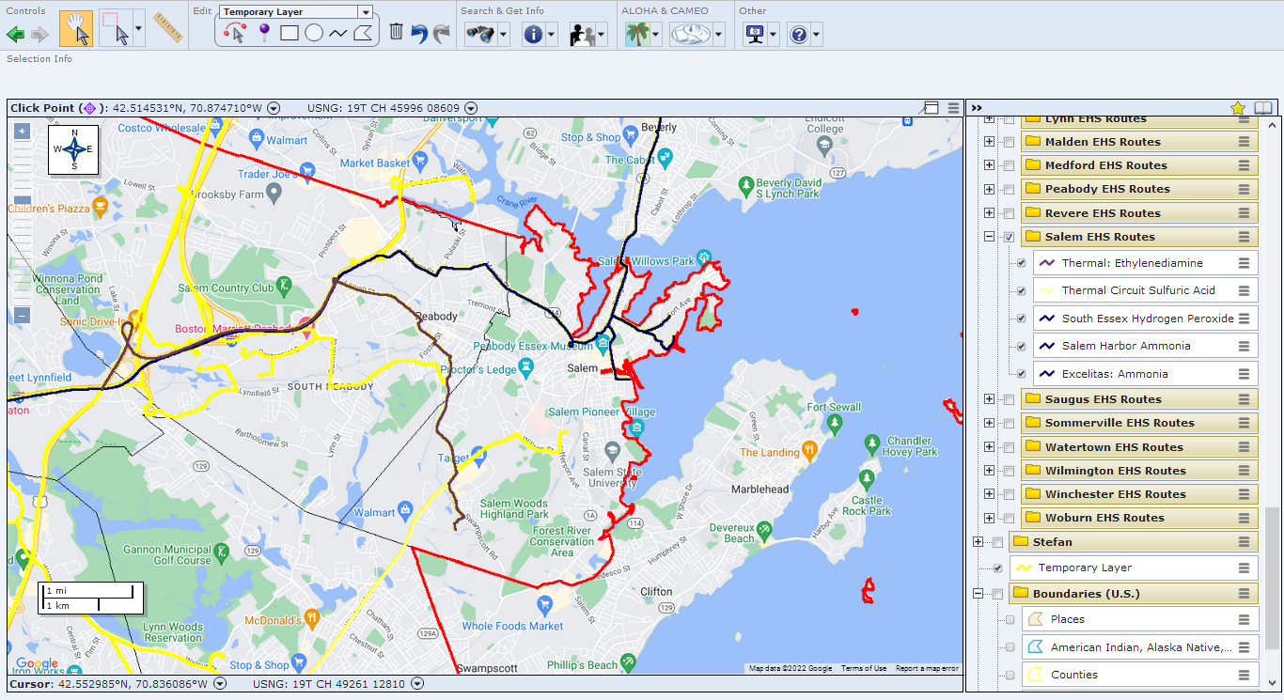
Notes:
Salem, MA: Reported information from Tier 2 regarding existing routes in their community.

Slide 21
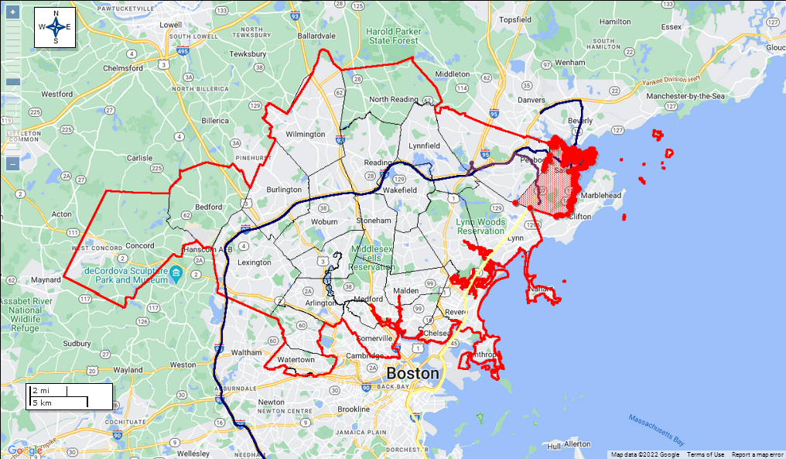
Notes:
However, notice that surrounding communities, that do not have a majority of these chemicals in inventory. They need to be aware of the potential.

Slide 22
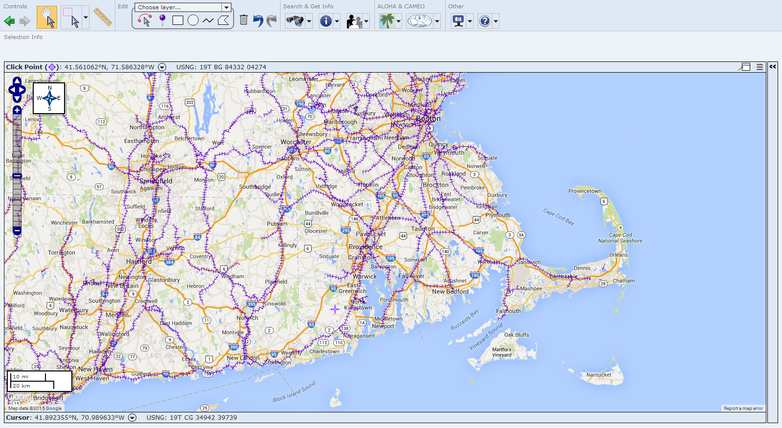
Transportation: Rail Scenario
Planning
First Response
Emergency Management
Notes:
How can we apply these concepts fro rail?

Slide 23
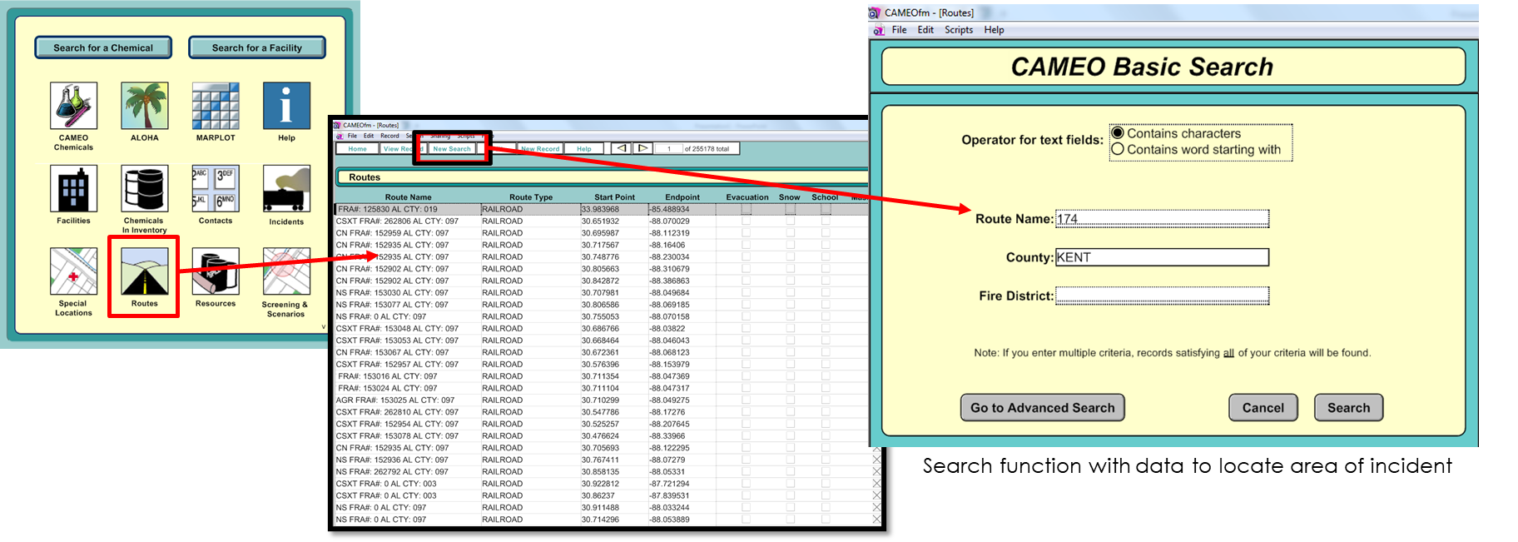
CAMEOfm Database: to confirm the location of the Incident
Notes:
An Amtrak locomotive has reported an issue Catenary Pole 174-46
Time: 4 PM
Weather: February, 17º F, Wind Chill: -2º F
Power has been cutoff to the entire train.
NOTE: CAMEO allows to record these incidents within its own module. (Perhaps a backup Dispatch CAD?)

Slide 24
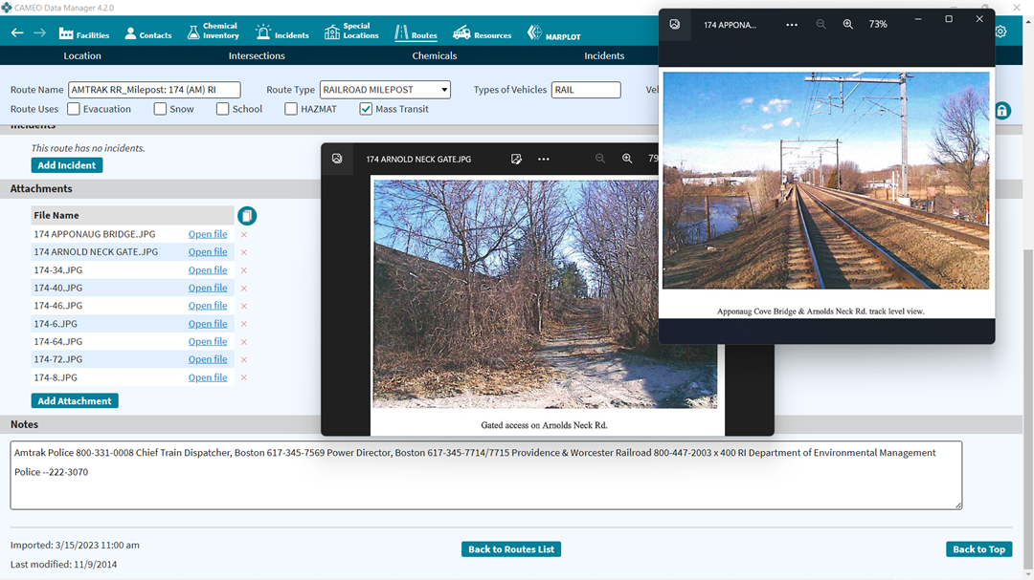
CAMEO DM Database: Routes Module
Notes:
If an agency has an existing database in older versions of the suite, all records will transfer into the newest versions with ease.

Slide 25
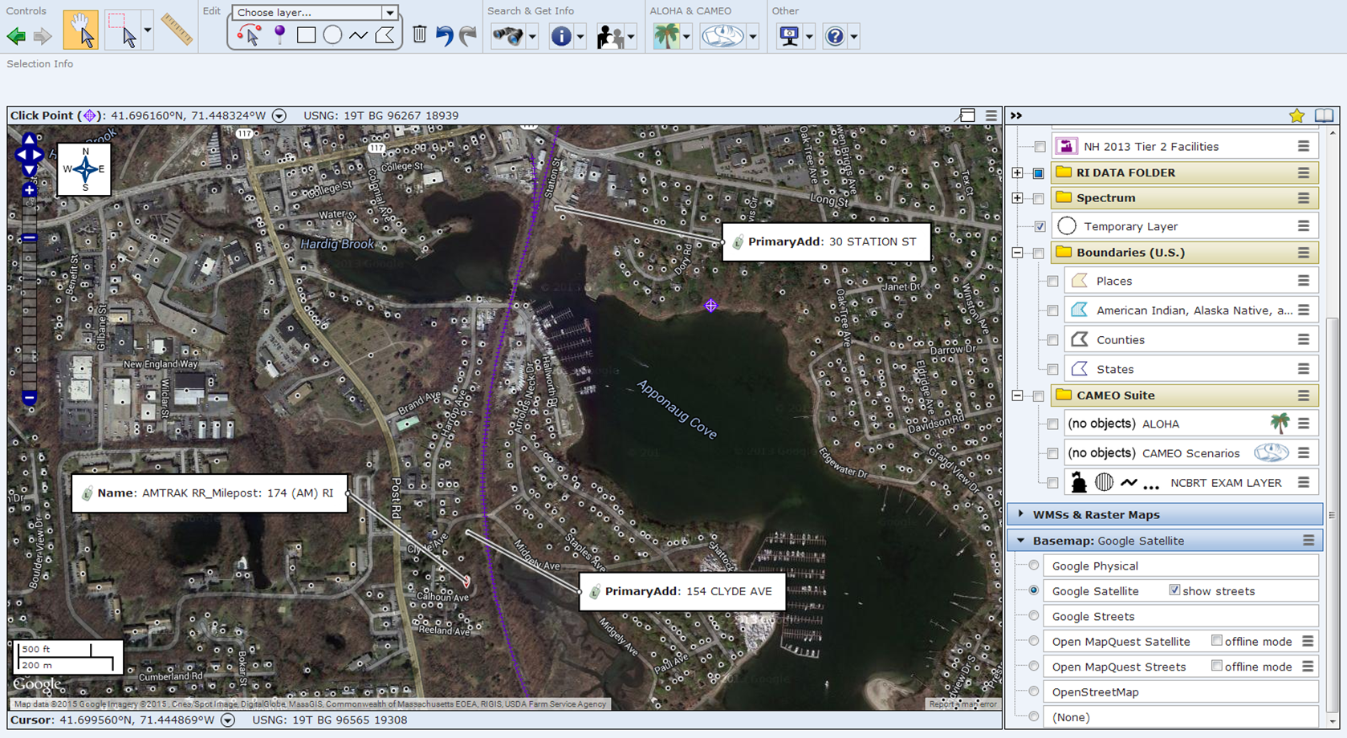
Aerial View of the Incident
Notes:
A picture says a 1000 words.

Slide 26
The Outcome
Ability to identify & locate trains in the event of an incident.
Assets can be located through mapping software by
latitude & longitude coordinates OR the US National Grid
Resources can be directed towards these assets or provide protective actions for them through access points along the tracks.
  i.e. Safely evacuating passengers and removing from the scene to another rail station, Hazmat situations
  Hazardous Material Inventories: 90% of the work has been completed

Slide 27
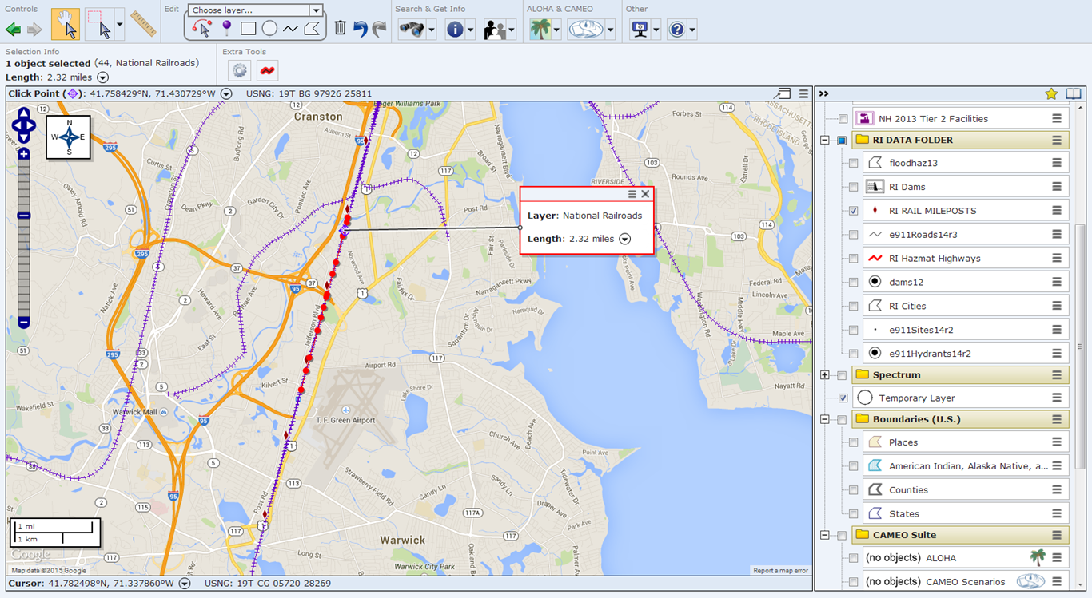
Hazardous Material Commodity Flow
Notes:
A make-shift commodity flow with known inventories. Common sense approach

Slide 28
Route Record: Rail
Notes:
Individual route record for the rail node
Chemical-In-Inventory Record for a railcar with an inventory of Chlorine

Slide 29
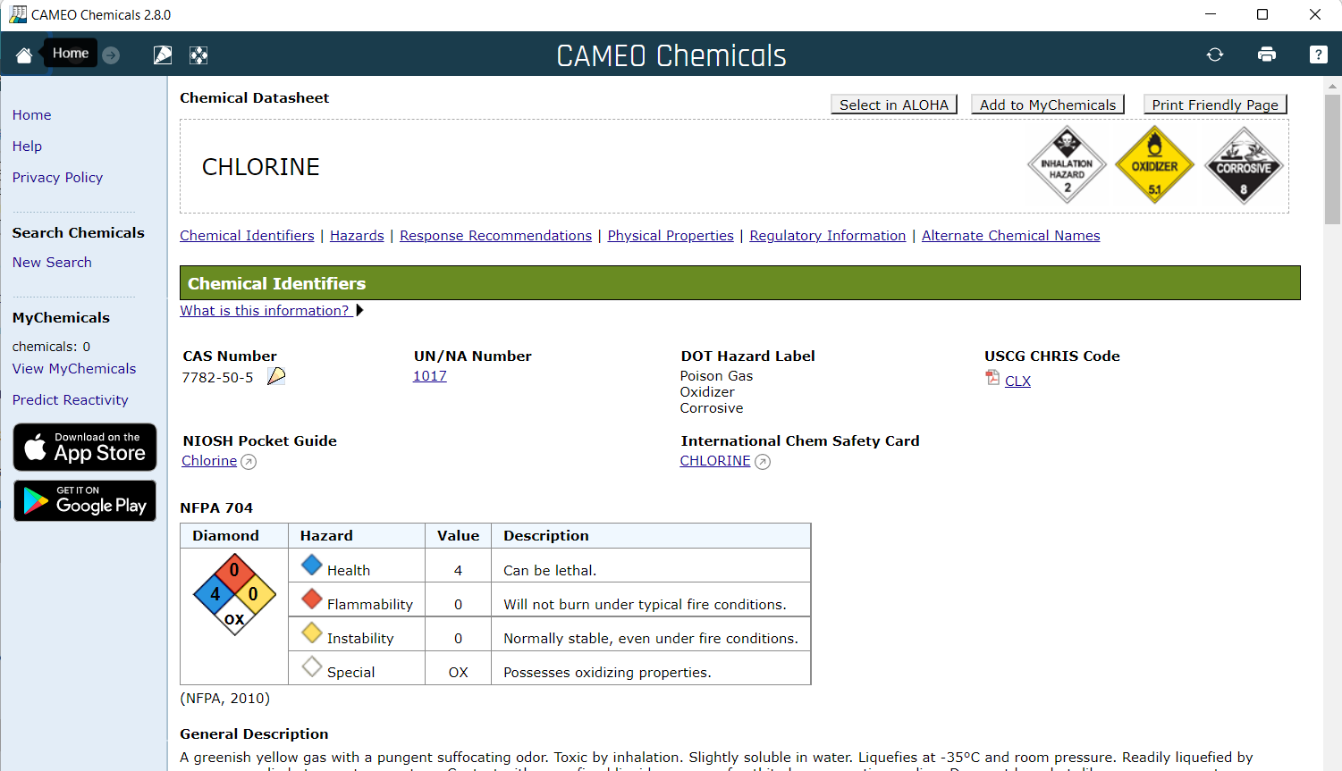





Access to CAMEO Chemical Datasheets
Notes:
Individual route record for the rail node
Chemical-In-Inventory Record for a railcar with an inventory of Chlorine
Accessibility to 3 resources immediately, 5 with an Internet connection for development of Incident Action Plan (IAP)

Slide 30
2020 Emergency Response Guidebook
Notes:
Current version of the ERG
Tables 1 & 3 available on the same screen.
Response guides available in English, Spanish, and French
Printable
Developers are exploring options to enhance capabilities of this software platform

Slide 31
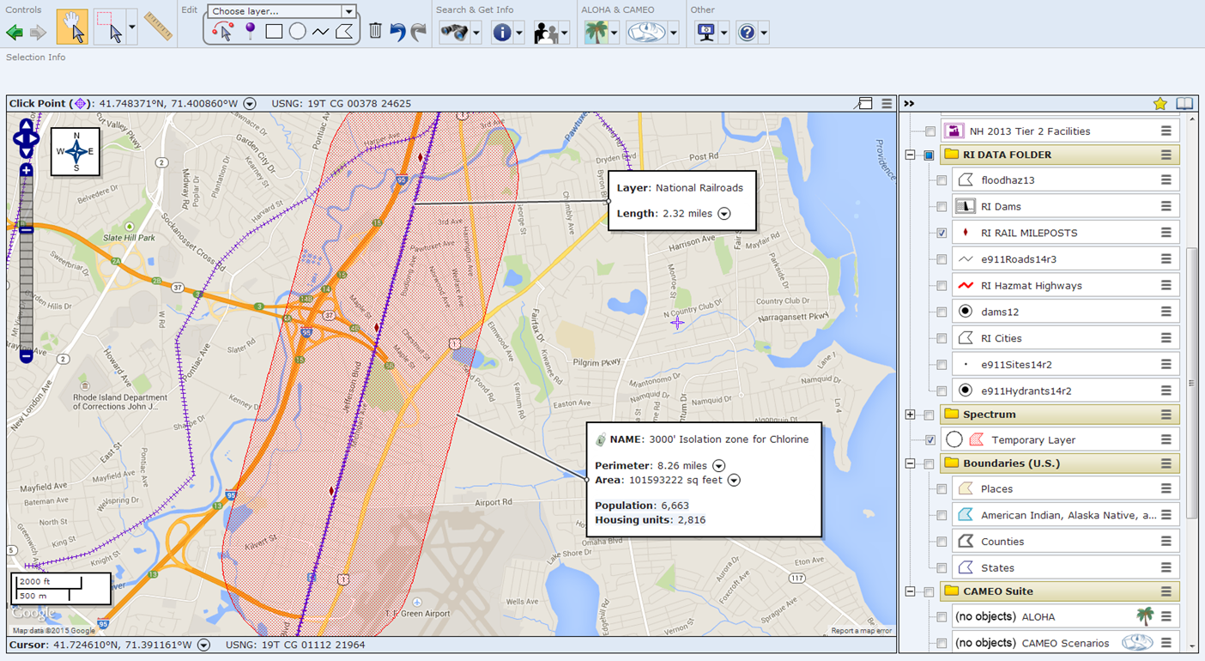
Strategic and Tactical Objectives
Notes:
Planners & Responders can determine affected hazard zones through emergency planning zones and hazard analysis (Emergency plans)
For example, according to the ERG, an immediate isolation distance for a Rail car with Chlorine is 3000’ in all directions.
As this is a prime example of how the RI database has been built within the Cameo Software Suite of programs; the database can be generated and developed to the needs of the host agency.
GIS shapefiles could fill-in any necessary gaps to the existing one in order to make it more functional.
Benefits: all programs are free and independent of any use of the Internet, although there is Internet functionality necessary for some other features.
Shortcomings: Databases need to be updated on an individual basis through email, networks, SharePoint capabilities.

Slide 32
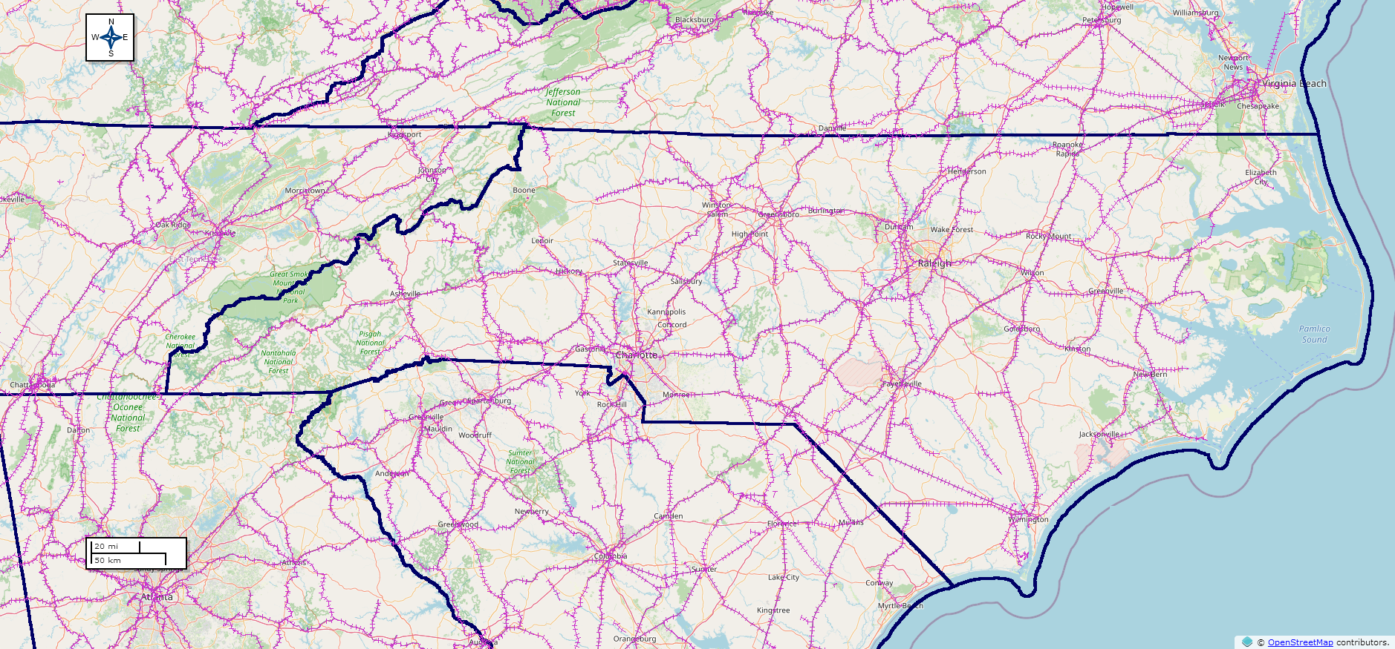
North Carolina Data
Notes:
We can enhance your CAMEO system with mapping locations of railroads and 3613 associated database records, representing 5,087 miles of rail line

Slide 33



Nicole Coldren
Doctorate Candidate California University of Pennsylvania
Dr. Thomas Mueller
California University of Pennsylvania
Notes:
MARPLOT_Cumberland_ME_EHS_Facilities_and_Routes has 17437 objects on 572 layers.

Slide 34
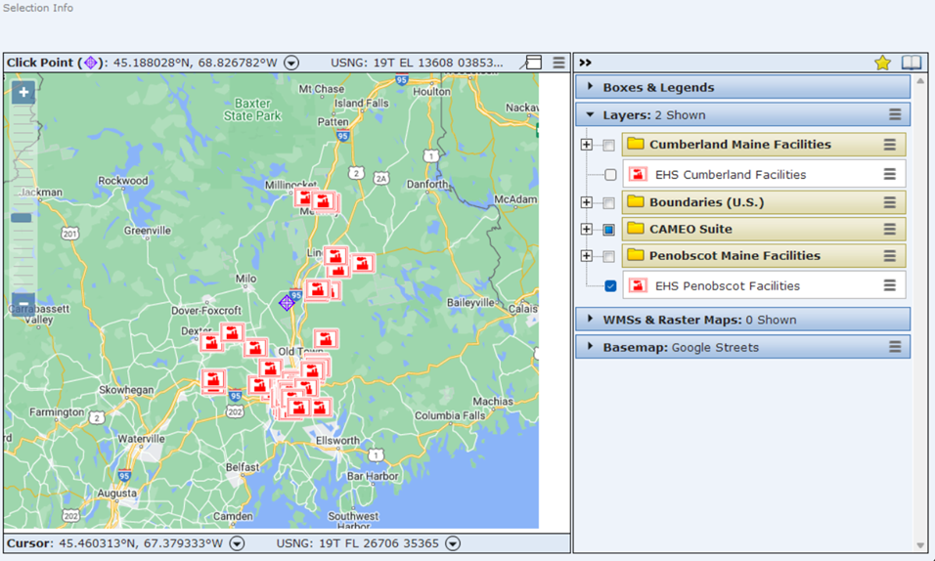
Notes:
MARPLOT_Cumberland_ME_EHS_Facilities_and_Routes has 17437 objects on 572 layers.

Slide 35
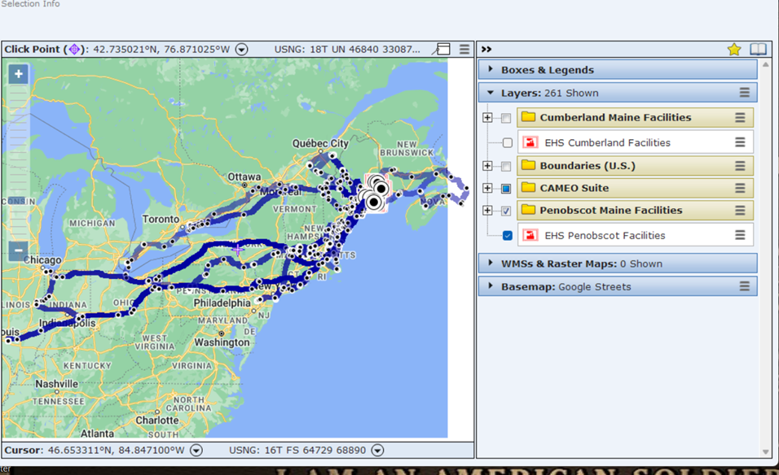
Notes:
MARPLOT_Cumberland_ME_EHS_Facilities_and_Routes has 17437 objects on 572 layers.

Slide 36
Moving forward
A community contact MUST be assigned
Develop simple policies for stakeholders to maintain a current database
Allow for the exchange of information between agencies
Foster relationships between our stakeholders
Involve the community
Additional training sessions

Slide 37
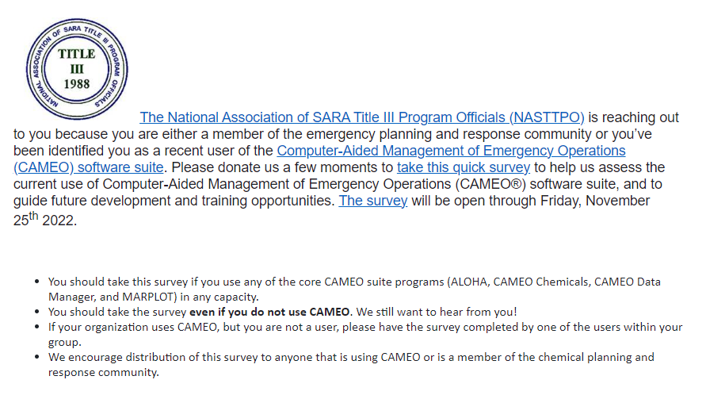

Slide 38
NCEM Hazardous Material Coordinators:
JR Griffin – Regional Response Team
Sarah Robison and Tom Steelman: Risk Management Program
Cole Owen – Hazardous Materials Emergency Planning Grant
E. Stefan Coutoulakis – EPCRA Tier II, CAMEO: Stefan.Coutoulakis@ncdps.gov
(984) 328-0923
Notes:
Light background slide with heading and text

Slide 39
Questions?
E. Stefan Coutoulakis
NC Department of Public Safety
Division of Emergency Management
Hazardous Materials Coordinator
984-328-0923
stefan.coutoulakis@ncdps.gov
Notes:
Nicole Coldren
and
Dr. Thomas Mueller
California University of Pennsylvania
Nicole Coldren
C11099000
Environmental Fisheries and Wildlife
California University of Pennsylvania
250 University Ave.,
California, PA 15419-1394

